Slide 1

Tracking Prediction system
Ohio Transportation

Slide 2

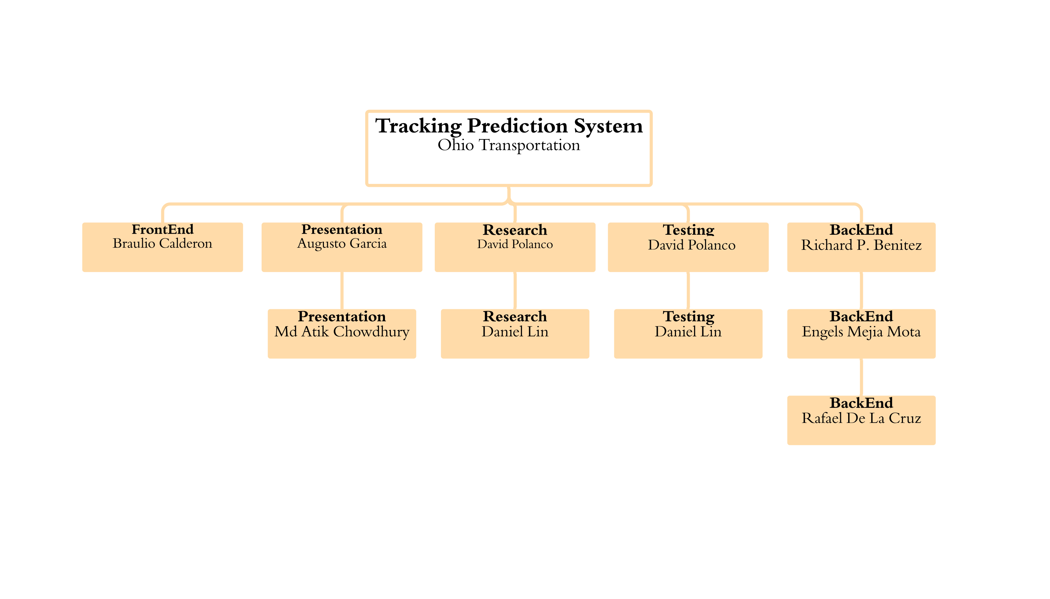
Team 3

Slide 3
Process of Communication
MICROSOFT TEAM
EMAILS
WHATS APP
GITHUB

Slide 4
Technologies
Libraries used: Mapbox gl, redux, react.js, Axios ( used in browser)
Google Platform Authentication
Heroku is our cloud and Clear DB to manage the MySQL database
BackEnd
Python
My SQL
Node JS
Express
GPS
Database
Firebase
FrontEnd
React

Slide 5
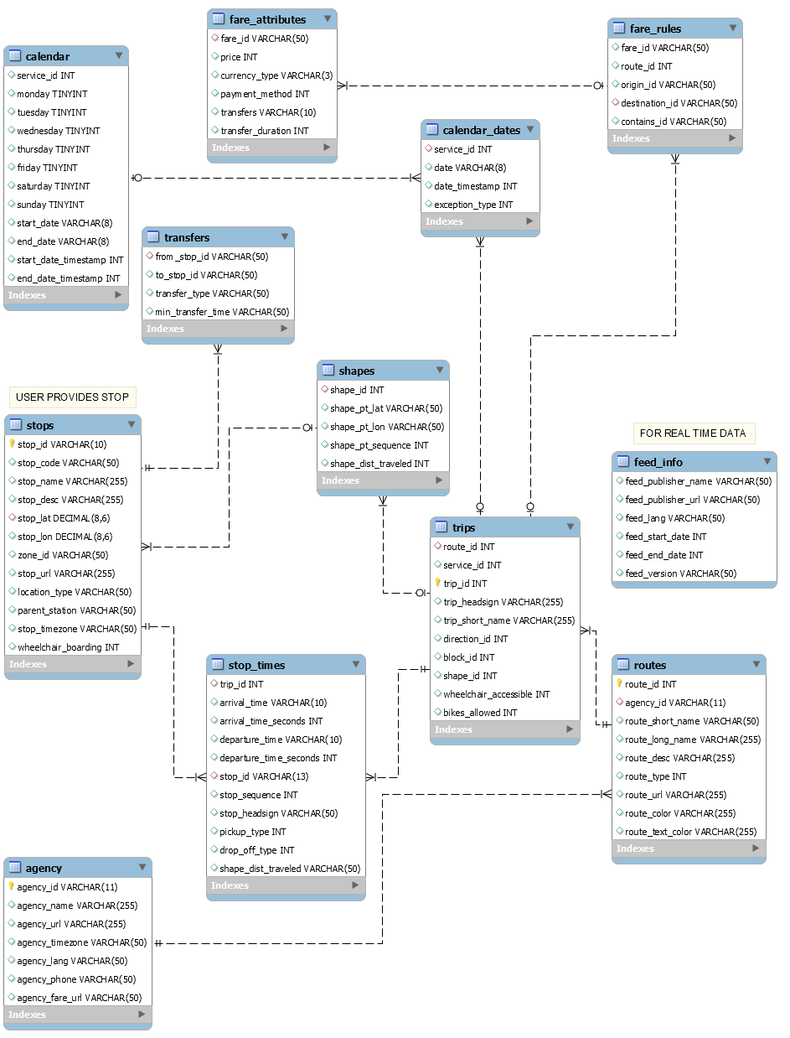
DataBase Diagram

Slide 6
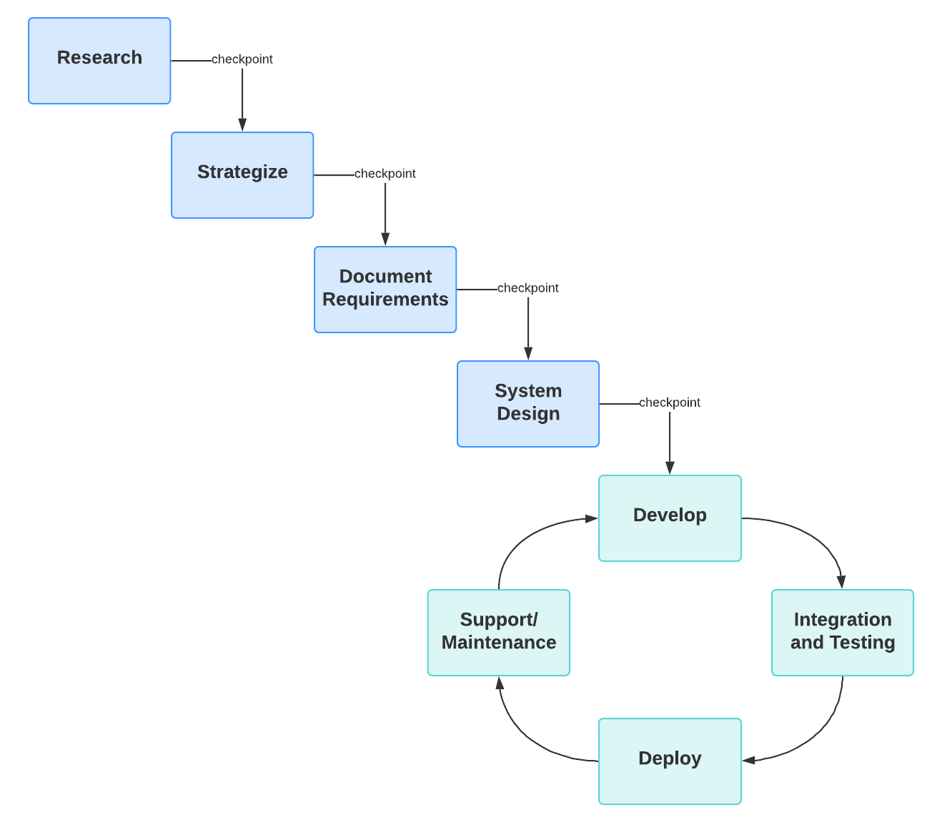
METHODOLOGIES
Agile-waterfall Hybrid Methodology

Slide 7
Requirements
User Requirement
System Requirement
Functional requirement

Slide 8
Introduction
Ohio Transit System (OTS) is a term applied to the Public Transport system using busses to provided faster, more efficient services than an ordinary heavy rail system.
It ensure fast, sustainable, reliable, secure and high capacity service.
Ohio transit system is a electric railway system characterized by it ability to operate single or multiple buses along exclusive right-of-way at ground level
A geographic information system is used to project each received location onto the underlying transit network. Then system implement as a finite state machine to ensure its regularity, stability, and robustness under a wide range of operating conditions.

Slide 9
Why OTS?
Affordable
More Convenient
Increases the service quality of the rail
Reduces the emission of green house gases
Reduces the traffic congestion
Less Energy consumption
Reduction of Usage of fossil fuels

Slide 10
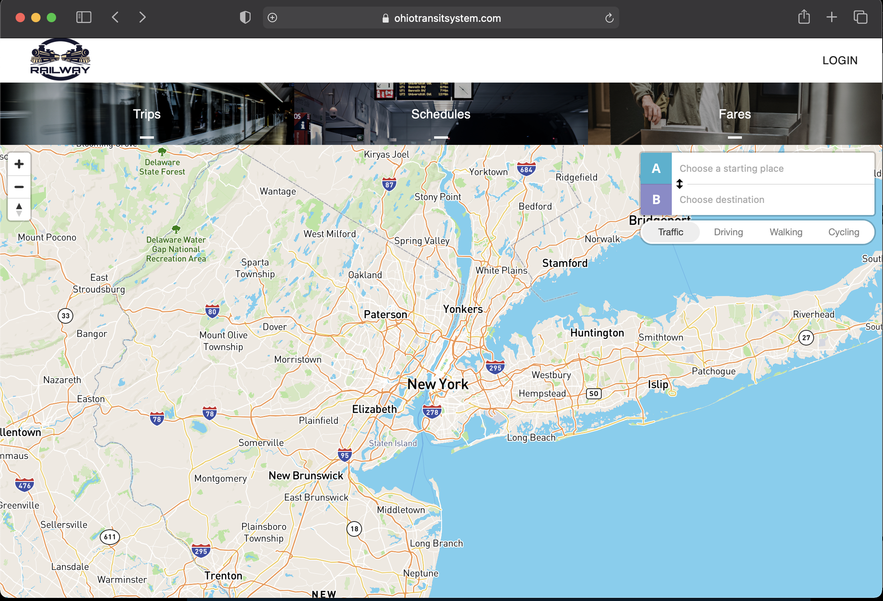
Design
Ohiotransitsystem.com

Slide 11
Domain
Customer centric web application in facilitating seamless scheduling between arrivals and departure times in Ohio transit stations.
Provides the ability to obtain accurate predictions .The buses arrival and departure times are vital to both Bus operation control and passenger information system.

Slide 12
Advantages
This system will help commuter to know about buses delay and timing
System will provide accurate details about the buses.
It will also provide valuable information for decision making to influence upselling, sales and revenue forecasting and even new product development.

Slide 13
Disadvantages
If the bus details are entered by the Admin is wrong so the system in the next station will show wrong information.
If there is any network failure the whole system will not work properly.

Slide 14
Conclusion
The result indicate that the proposed system is capable of achieving satisfactory accuracy in predicting bus arrival times and perfect performance in predicting travel direction.

